Slide 1
Group Id: P10
Name Of Guide: Dr. Geetha Chillarge
Title Of BE project: Krishi Sanstha
Domain OF Project: Full Stack / AI & ML
Name of Group Members:
Ishan Wagh BC259
Aryan Shinde BC160
Bhaghyesh Shah BC2
Swapnil Patil BC2

Slide 2

Krishi Sanstha: Empowering Indian Agriculture
Changing farming for the better with an all-in-one online platform that helps farmers connect, grow, and succeed together.

Slide 3




Our Vision: A Connected Agricultural Ecosystem
Krishi Sanstha aims to bridge critical gaps in the agricultural sector by providing a unified digital platform. We envision a future where every farmer has access to information, markets, and support, fostering sustainable growth and prosperity.
Farmer Communication Network
E-Commerce for Products
Connecting farmers for shared knowledge and support.
Direct market access for crops and produce.
Advanced Weather Forecasting
Disease Detection & Analysis
Timely weather intelligence for informed decisions.
AI-powered solutions for crop health.

Slide 4
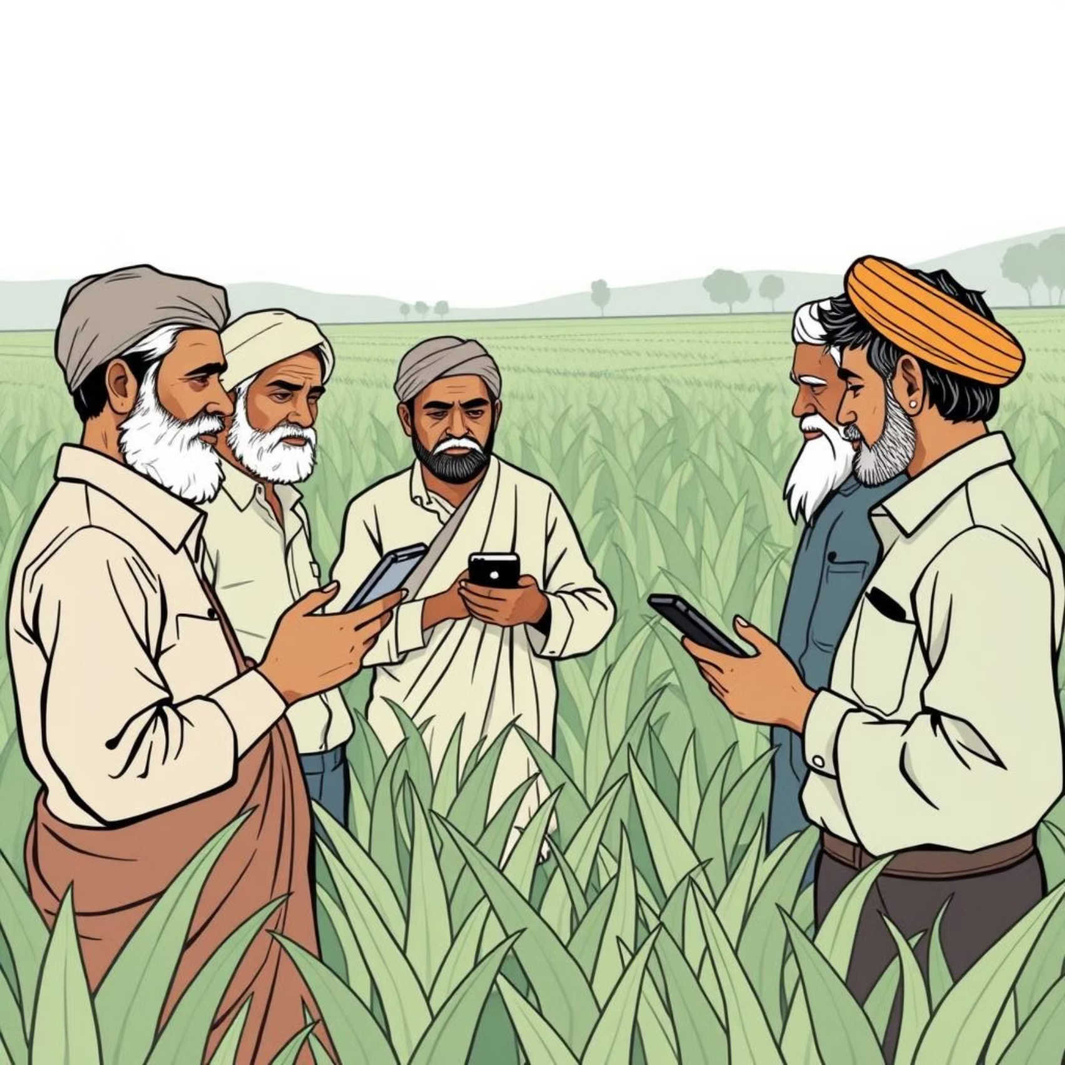
Farmer Communication Network
Helping farmers, experts, and others easily talk and work together to share ideas, knowledge, and good farming methods.
Voice message option to help farmers who can't read or write well.
Chat rooms and discussion forums based on area or type of crop.
Support for many Indian languages using smart language tools.
Special “Ask the Expert” sessions where farmers can talk directly.

Slide 5




E-Commerce for Agricultural Products
Helping farmers sell their crops directly to more buyers,
so they get fair prices and quick payments.
Crop Listing
Buyer Search
Farmers can easily list their crops and yield for sale.
Buyers can search and filter by crop, region, season, or price.
Secure Payments
Logistics Support
Integrated with UPI and bank transfers for secure transactions.
Partnership options with India Post and local delivery networks.

Slide 6

Real-time Weather Forecasting
Providing accurate and timely weather data to help farmers make informed decisions about
planting, irrigation, and harvesting.
Real-time weather data using APIs (e.g., OpenWeather, IMD).
Custom alerts for rain, frost, drought, and more based on location.
Interactive forecast dashboards for precise crop planning.
Historical weather data for long-term climate analysis.

Slide 7
AI-Powered Crop Disease Detection & Analysis
Using smart AI tools to quickly find crop diseases and suggest the best ways to treat them.
Image Upload
AI/ML Detection
Farmers upload images of affected crops for instant diagnosis.
CNN models detect diseases with high accuracy.
Treatment Suggestions
Community Reporting
Receive immediate treatment options and pesticide recommendations.
Report new infestations to alert and mobilize the farming community.

Slide 8

Digital Krishi Diary: Smart Farm Management
A simple digital notebook for farmers to keep track of their farm work, helping them manage better and earn more profit.
Daily log to track yield, soil quality, and water usage.
Detailed income and expense tracking for financial clarity.
Interactive graphs and insights for optimized farm management.
Record and monitor investments for long-term planning.

Slide 9
Marketplace for Tools & Seeds
A dedicated section to buy or rent essential farm equipment and procure certified seeds and fertilizers, fostering resource efficiency.
Equipment Access
Certified Inputs
User Reviews
Buy or rent a wide range of farm equipment and machinery.
Access to certified seeds, high-quality fertilizers, and crop protection products.
Benefit from community reviews and ratings for informed purchasing decisions.

Slide 10
Our Key Stakeholders
Krishi Sanstha is made to help all types of users, giving full support for
the growth of farming in every way.
Farmers
Agencies
Buyers
Researchers
Primary beneficiaries, empowered with information and market access.
Government bodies utilizing data for policy-making and rural development.
Retailers, wholesalers, and consumers directly sourcing agricultural products.
Agricultural scientists and consultants leveraging data for research and advisory.

